Slide 1

Quality-Aware JPEG Restoration Using a Cascaded Deep Network with Hybrid Spatial–Frequency Loss
Arunkumaran 23MIA1171
GVN Kishore 23MIA1157
S Akshadh Athreya 23MIA1065
Faculty: Dr. Geetha S

Slide 2






Motivation & Problem Statement
The Problem: JPEG Artifacts
The Challenge: "Blind" Restoration
The Goal: A Balanced Model
The JPEG compression standard, while essential, introduces visual artifacts like blockiness, ringing, and noise that degrade image quality.
Most models need to know the exact compression level (QF) to work. Restoring an image *without* this knowledge is the "blind" problem.
Implement a model that balances high-fidelity restoration, blind applicability (works on any QF), and computational efficiency.

Slide 3
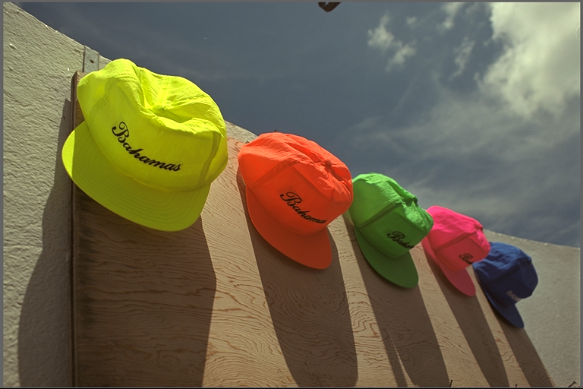

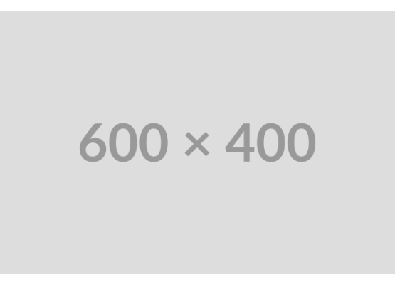
Base Paper Summary:
Paper: "Efficient and Effective Blind JPEG Image Improvement..." (Ezumi and Ikehara, 2024)
Architecture: A novel cascaded design, not a single pass.
1. Quality Estimation (QE) Part: A controller that analyzes the input to create a quality representation.
2. Image Processing (IP) Parts: A series of U-Net-based (N=6) structures that progressively refine the image.
Key Technique: "Role Sharing" - a dynamic loss weighted across all IP parts, using fewer stages for high-QF images and more for low-QF.

Slide 4
Methodology Flow
2. Network Input
4. Final Output
The 4D tensor is fed into the network, allowing it to adapt to the quality level.
The final restored 3-channel (RGB) image is produced from the last IP Part.
1. Input & Conditioning
3. Sequential Processing
A 3-channel (RGB) image and its Quality Factor (QF) are combined into a 4-channel (R, G, B, Q) tensor.
The tensor passes through the N=6 cascaded IP Parts, with each part progressively refining the image.

Slide 5
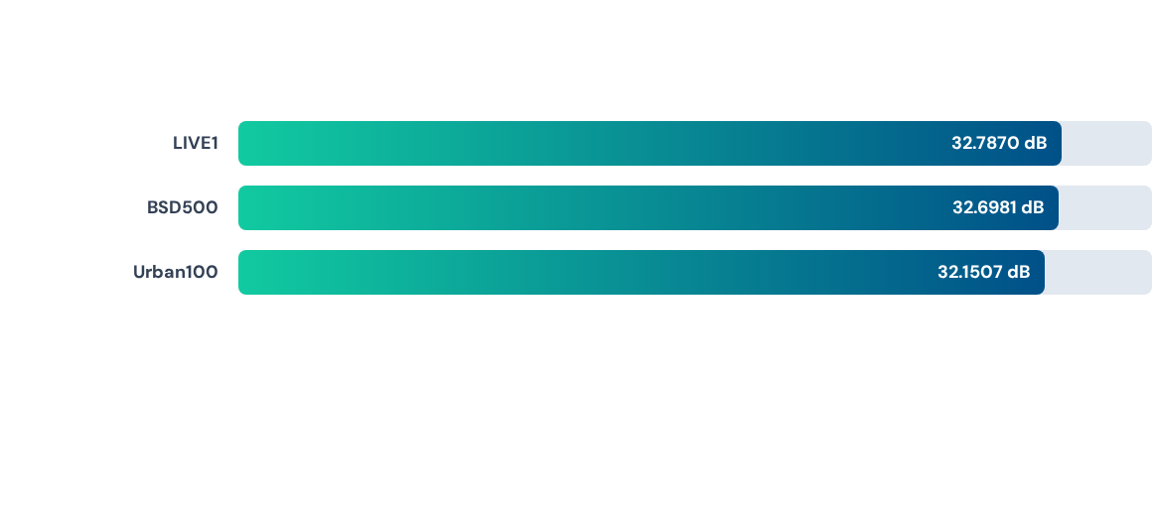
Quantitative Results: Average PSNR
Overall Average PSNR: 32.5453 dB | Overall Average SSIM: 0.9132
Results are consistently high and stable across all three standard benchmarks, validating the model's effectiveness.

Slide 6
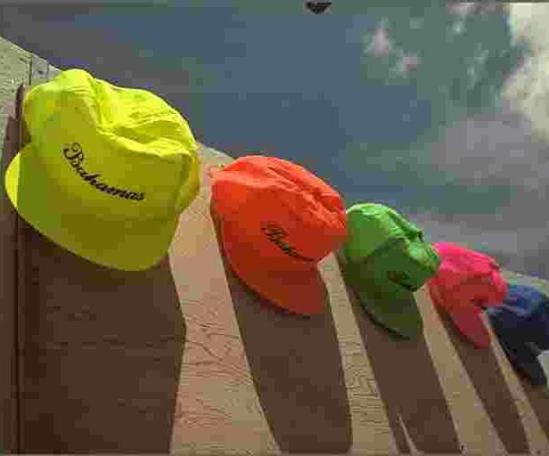




Qualitative Results (LIVE1 Dataset: "caps.png")
Ground Truth
Compressed Input (QF 10)
Our Restored Output

Slide 7
Key Findings & Future Enhancements
Successfully Validated: Confirmed the viability and effectiveness of the sequential processing approach for blind artifact removal.
High Performance: Achieved an overall average PSNR of 32.5453 dB and SSIM of 0.9132 across all benchmarks using the pre-trained model.
Qualitative Success: The model effectively removes severe blocky artifacts and restores fine details, appearing significantly closer to the ground truth.
Training Instability: A notable observation during our *own* training attempt was that performance diverged after the initial epochs..
Future Work: This instability should be investigated. Tuning the optimizer (Adam) or the cosine-decay learning rate schedule could enable a full, stable training run.

Slide 8
Thank You

